Slide 1

Arabic Speech Recognition System using Deep Learning
This project explores the development of an Arabic speech recognition system using deep learning techniques. The system combines an acoustic model and a language model to accurately transcribe Arabic speech into text.

Slide 2
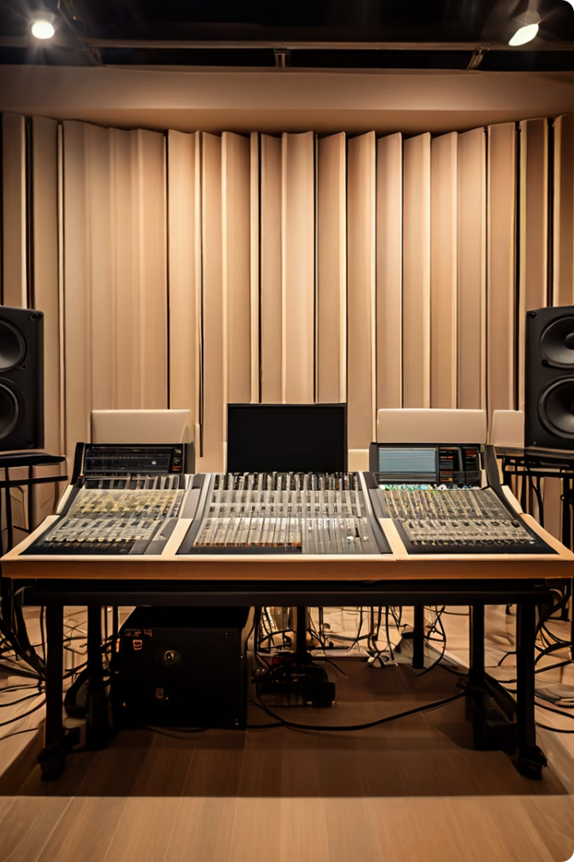
Dataset Overview
1
Arabic-EGY-ASR-16K Dataset
The dataset used for training and evaluation consists of 16,000 audio recordings of Egyptian Arabic speech.
2
Audio File Format
The audio files are stored in standard WAV format with a sampling rate of 16kHz.
3
Transcriptions
Each audio recording is paired with a text transcription of the spoken content.

Slide 3
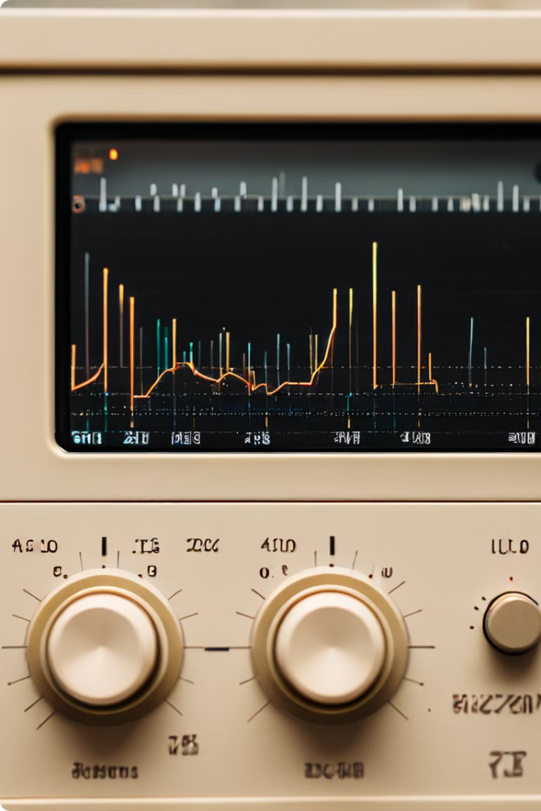
Audio Data Preprocessing
1
Noise Reduction
The audio files are preprocessed to remove background noise and enhance the speech signal.
2
Normalization
The audio data is normalized to ensure consistent volume levels across the dataset.
3
Feature Extraction
Acoustic features, such as Mel-Frequency Cepstral Coefficients (MFCCs), are extracted from the audio data.

Slide 4
Acoustic Model Architecture
Input Layer
Hidden Layers
Output Layer
The input to the acoustic model is the sequence of audio features extracted from the preprocessed speech data.
The model utilizes a combination of LSTM layers and convolutional neural network (CNN) layers to learn the complex patterns in the speech data.
The output of the acoustic model is a probability distribution over the Arabic phonemes, which is then used by the language model for transcription.

Slide 5
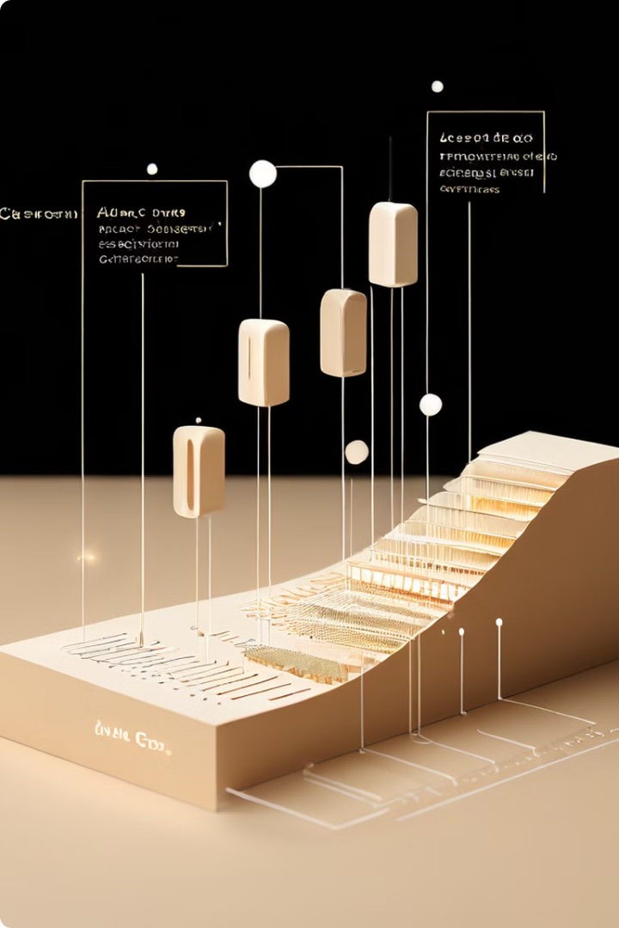
Language Model Integration
N-gram Language Model
A statistical n-gram language model is used to capture the patterns and constraints of the Arabic language.
Beam Search Decoding
The acoustic model's output is combined with the language model using a beam search decoding algorithm to generate the most probable transcription.
Hybrid Approach
The combination of the acoustic model and the language model improves the overall accuracy and robustness of the speech recognition system.

Slide 6
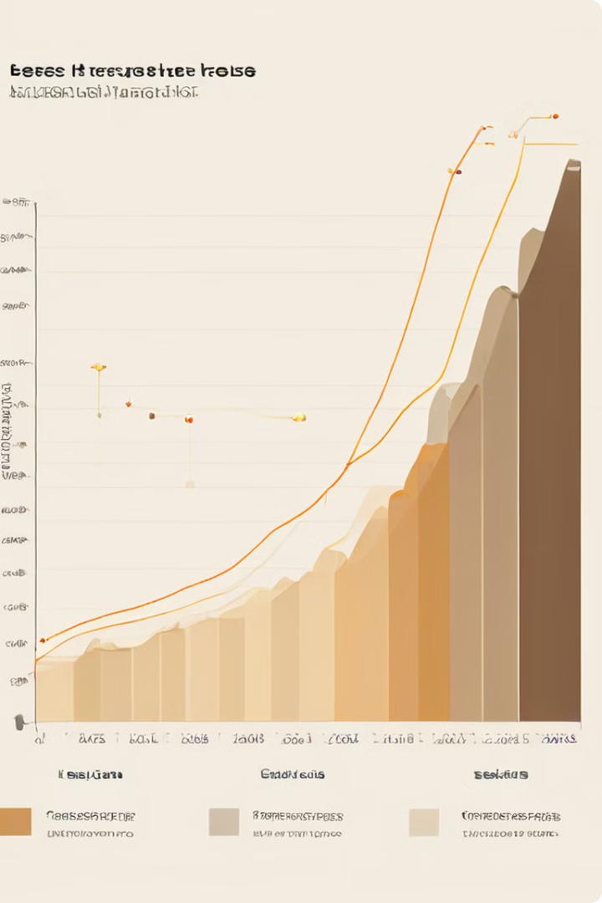
Training Procedure
1
Data Augmentation
To improve model generalization, the training data is augmented through techniques such as pitch shifting and time stretching.
2
Transfer Learning
The acoustic model is initialized with pre-trained weights from a large-scale speech recognition model, then fine-tuned on the Arabic dataset.
3
Optimization
The model is trained using the Adam optimization algorithm, and the learning rate is adjusted during training to ensure convergence.

Slide 7
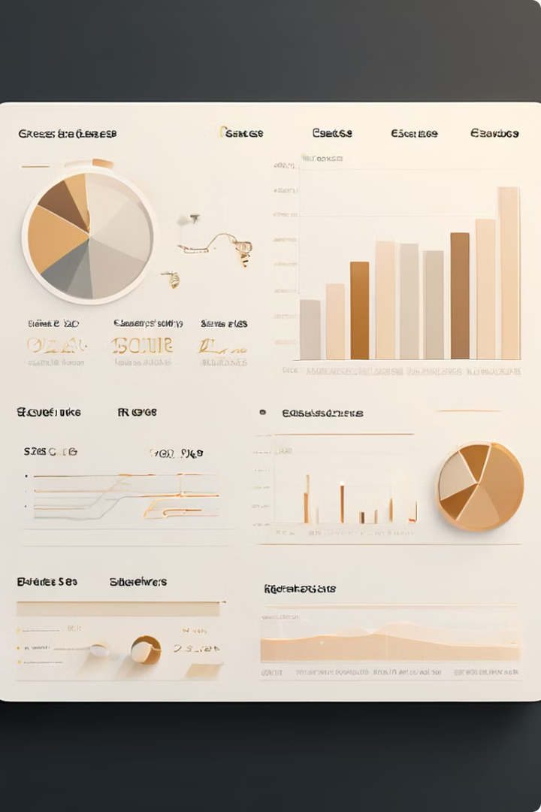



Evaluation Metrics
Word Error Rate (WER)
The primary evaluation metric is the Word Error Rate, which measures the edit distance between the predicted and the ground-truth transcriptions.
Accuracy
The overall accuracy of the system is also calculated, reflecting the percentage of correctly transcribed words.
Confidence Scores
The confidence scores associated with the transcriptions are used to assess the model's uncertainty and reliability.

Slide 8




Deployment and Integration
Live Audio Input
The system can be deployed to accept live audio input from microphones or other recording devices.
API Integration
The speech recognition system can be integrated into other applications through a well-documented API.
User Interface
The transcribed text can be displayed in a user-friendly interface, such as a mobile app or a web-based platform.

Slide 9
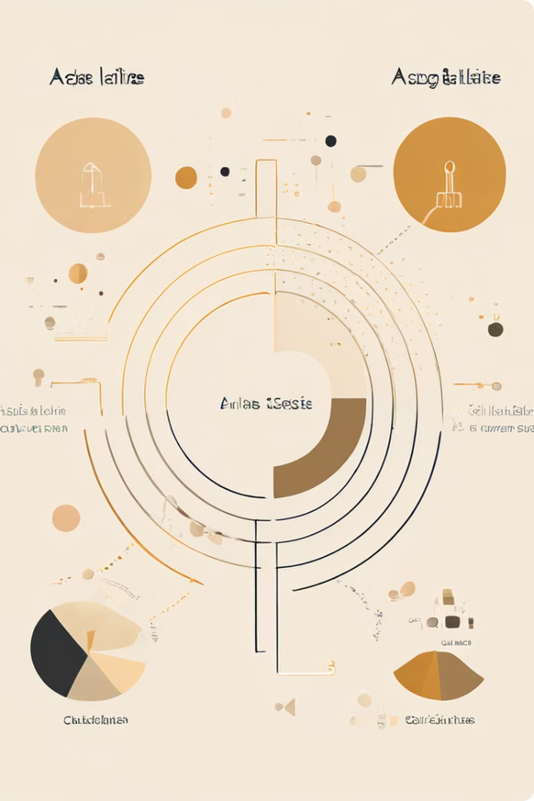
Challenges and Limitations
1
Dialect Variation
The system may struggle with handling the diverse dialects and accents present in the Arabic language.
2
Background Noise
Noisy environments can degrade the performance of the system, requiring advanced noise reduction techniques.
3
Limited Data
The lack of large-scale, high-quality Arabic speech datasets can hinder the development of more accurate models.

Slide 10

Future Enhancements
Multi-lingual Support
Expanding the system to support multiple languages, including Modern Standard Arabic and other regional dialects.
Personalization
Developing techniques to adapt the system to individual users' voices and speech patterns for improved accuracy.
Integration with AI Assistants
Integrating the speech recognition system with virtual assistants and smart home devices for seamless voice interactions.

